Slide 1
A House Divided
Influence in
The 114th United States Senate

Slide 2
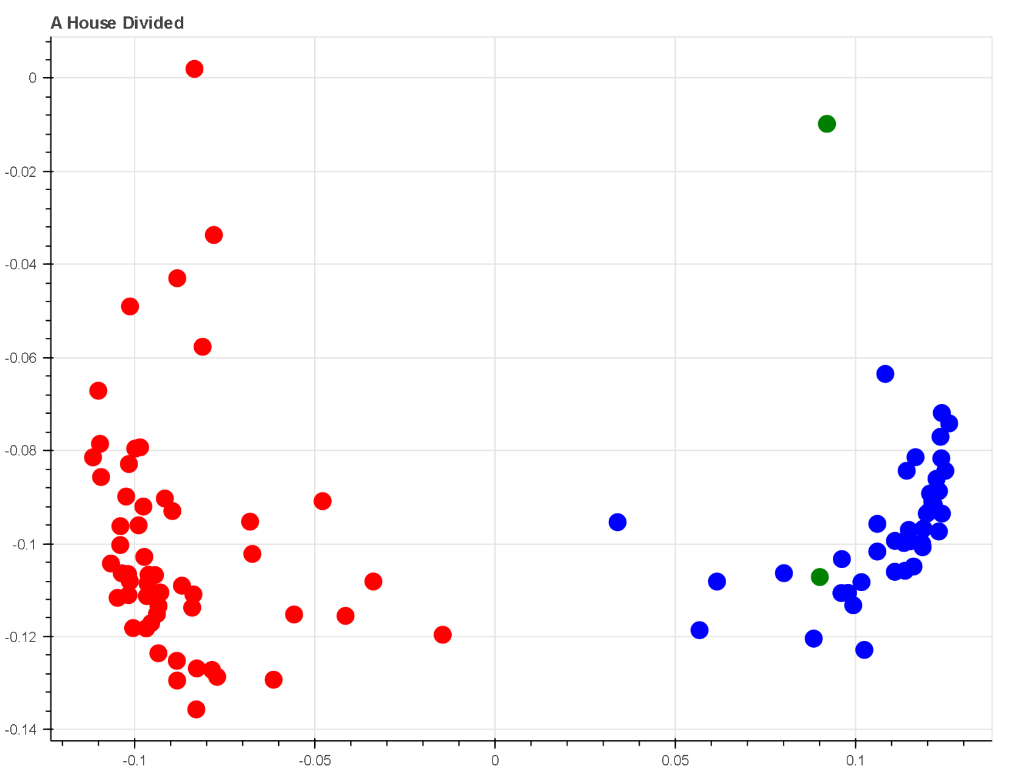
Voting Party Line

Slide 3
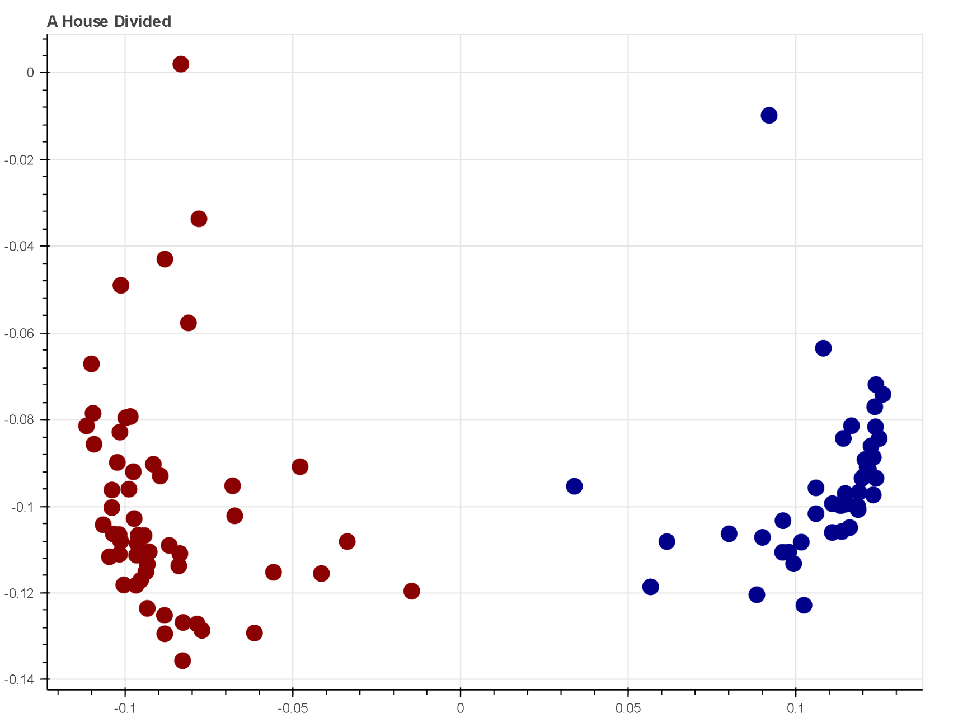
Clustering

Slide 4
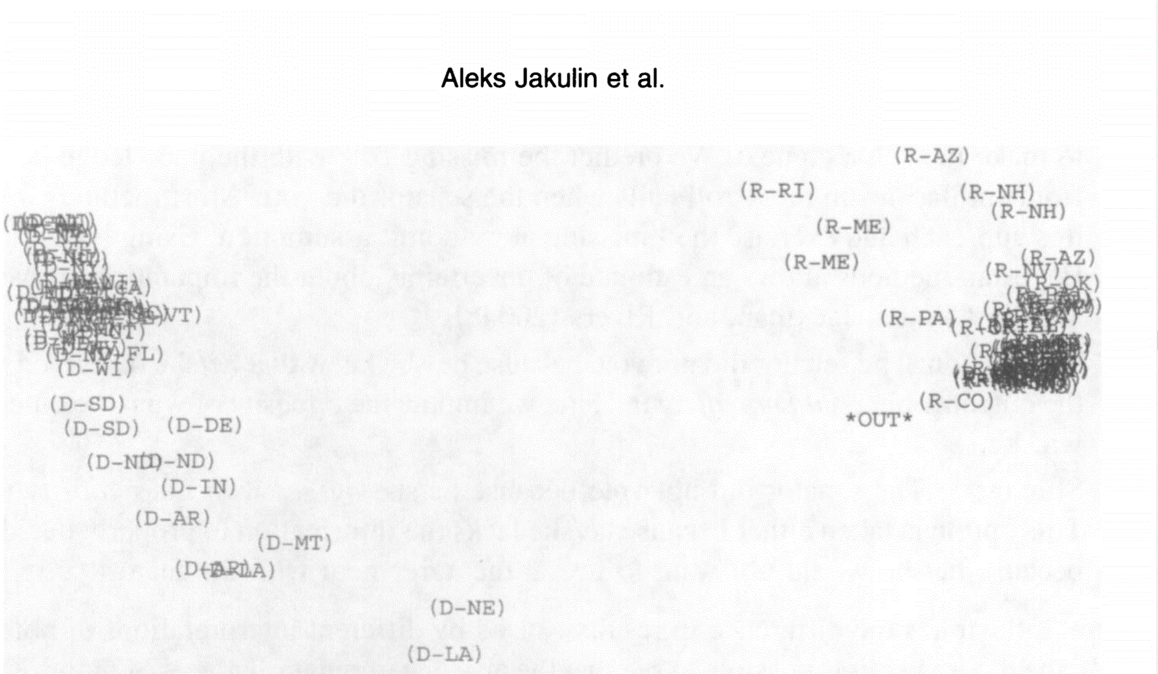
2003 US Senate

Slide 5
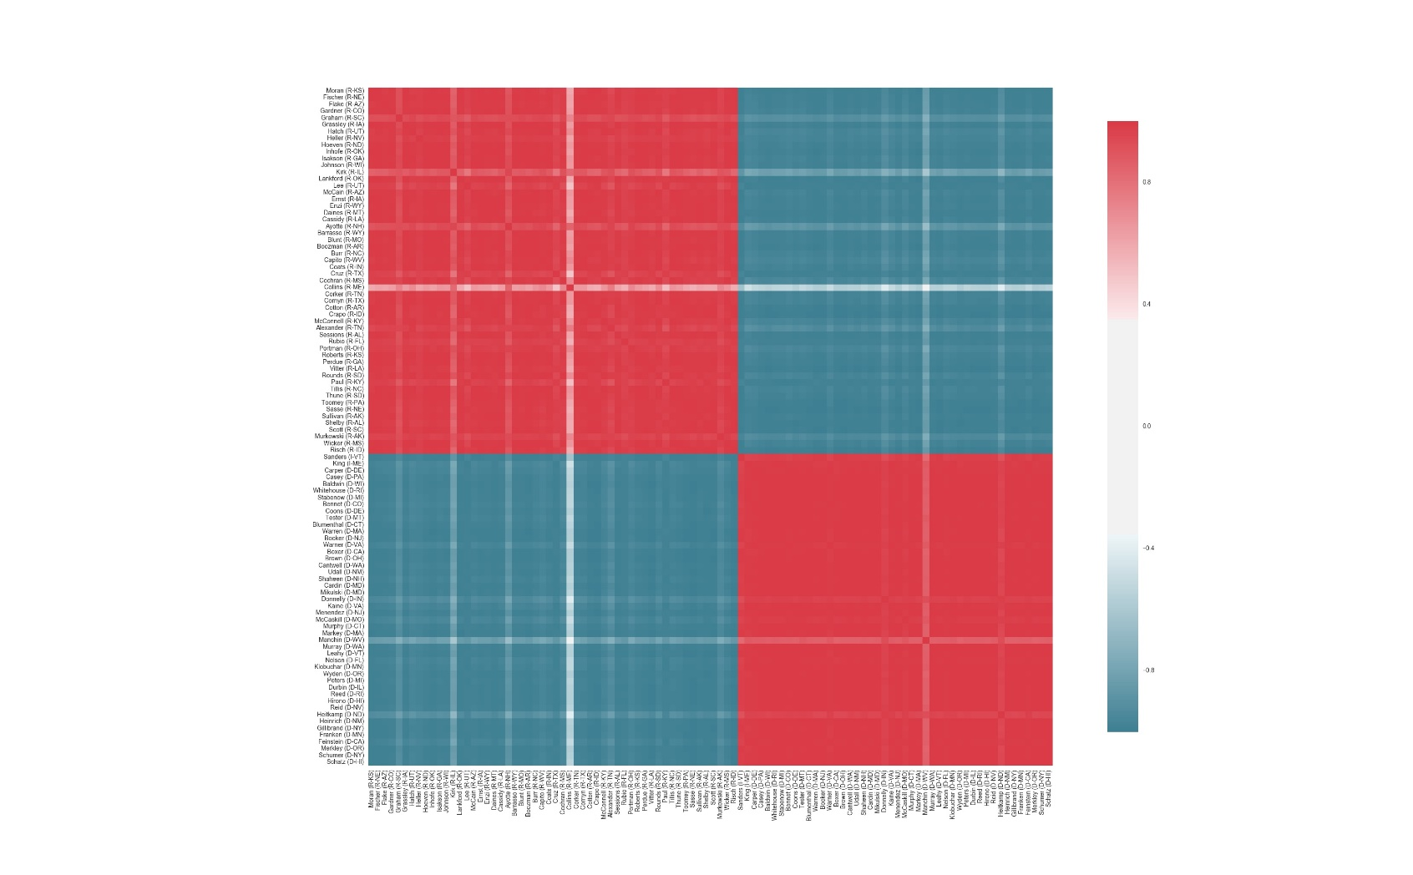
Roll Call
The Party Line
The similarity between
voting records of each Senator, 114th US Congress
Voting records follow party lines strongly.

Slide 6
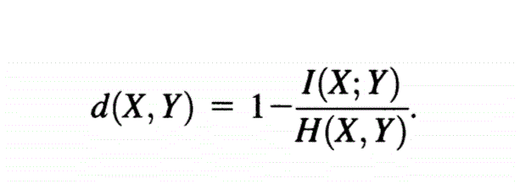
No Brass Tacks
Can we find the source of the divide?
Influence
H(Y) – H(Y|X) = I(X;Y)
Measuring Influence and the Theory of Mutual Information
Influence is the reduction in uncertainty about one vote based on information about another vote
Distance Metric

